Slide 1
Chelating Agents
Dr. Ashok Kumar Jain
Pharmacology Department

Slide 2
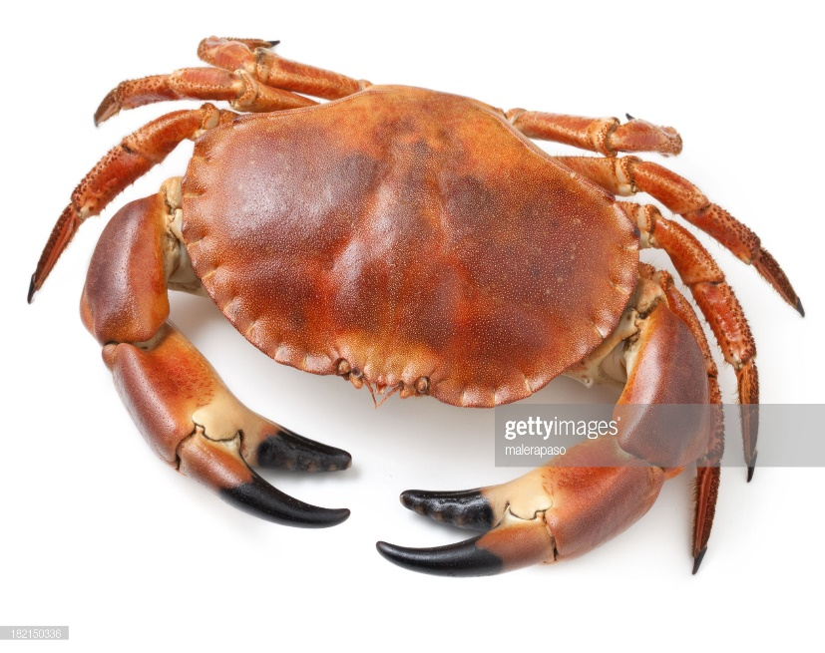

Chelating Agents
Greek chele = crab
1° used in heavy metal poisonings, holds metal like a crab’s claw
Heavy metals exert toxic effects by combining with (ligands) of enzymes or other critical biomolecules and inactivating functional groups
Contain ≥2 reactive groups (ligands) which can bind metal from at least 2 sides so that a ring is formed.
Chelation is Chemical antagonism drug counters the effect of another by simple chemical reaction / neutralization(not binding to the receptor)

Slide 3
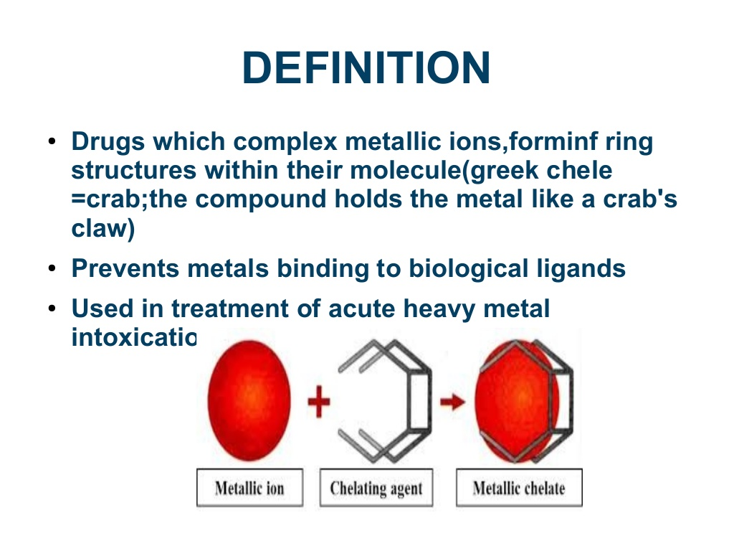
Mechanism of action Chelating agent(drug)+Metal ion ↓ Non toxic water soluble complex ↓ Eliminated by kidney

Slide 5
Metal toxicity toxic effects depend on:
Nutritional status
Age
Gender
Route of exposure
Amount
Tissue distribution
Accumulation
Excretion

Slide 6
Properties Of Ideal Chelator
Greater Affinity, Low Toxicity
Ability to compete with natural chelators (include ferritin, transferrin, & lactoferrin for iron, ceruloplasmin for copper, and metallothionein(MT) for other metals) aka Preventative antioxidants rather than protective antioxidants
Resistance to bio transformation
Ability to reach metal storage sites
Capacity to form stable and non toxic complexes
Ability to penetrate cell membranes

Slide 7
Properties Of Ideal Chelator
High water solubility
Rapid excretion of complex
Same distribution as the metal
Retain chelating ability at pH of body fluids
Low affinity for essential metals like Ca and Zn as they often act through competition with these metals
Contain ≥2 reactive groups (ligands) which hold metal from at least two sides so that a ring is formed.(5-7 membered ring is most stable)

Slide 8
Efficacy declines rapidly as the interval increases between metal entry and the administration of the chelator

Slide 9
Ferritin
Ferritin mainly present as L-form in body central core where Fe stored as ferric oxohydroxide
One ferritin molecule can store up to 4500 atoms of iron
All storage proteins have much higher affinity for Fe3+ iron than Fe2+ therefore have to oxidize any Fe2+ for binding (ferroxidase activity)
Principally Fe and Cu toxicities related to their abilities to participate in e- transfer reactions.
When existing free (most particularly Fe & Cu) can catalyze damaging free radical reactions
Extremely reactive hydroxyl radical may generate from O2 in the presence of H2O2 and Fe
This reaction mechanism is a type of Fenton chemistry known as the iron-catalyzed Haber-Weiss reaction

Slide 10
Chelating agents useful as drugs:
Dimercaprol (BAL)
Dimercaptosuccinic acid (Succimer)
Penicillamine
Desferrioxamine
Disodium edetate
Deferiprone
Calcium disodium edetate
Trientine

Slide 11
Chelating agents
Drug | Antidote
Iron | Deferoxamine, Deferiprone , Deferasirox
Lead/Gold | Dimercaprol, Penicillamine,Succimer, (also EDTA for Lead)
Copper, Arsenic | Penicillamine
(de-Fe-roxamine)
Arsenic, Mercury, | Dimercaprol, Succimer

Slide 12
(Dimercaprol/ BAL) picture from Themis atlas pharmacology 3e,P302

Slide 13
BAL and related compound

Slide 14
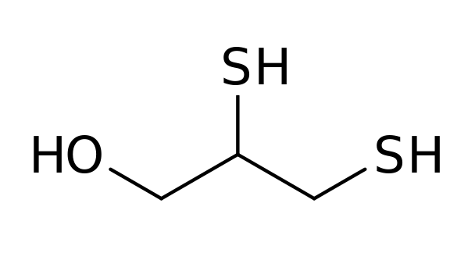
Dimercaprol (British antilewisite; BAL)
BAL has 3-carbon backbone c̅ two sulfhydryl (–SH) groups and a hydroxyl group.
Oily viscous liquid c̅ pungent mercaptan(rotten egg) smell
1st chelating agent used clinically developed during WW-II by Britishers as antidote to arsenical war gas lewisite.
forms complexes between two sulfhydryl groups and arsenic
detoxifies lewisite by forming a five membered stable complex with Aresenic
Lewisite BAL 5 membered ring complex

Slide 15
Precaution
Dimercaprol -metal complex dissociates faster in acidic urine and released metal can damage the kidney
Therefore urine is alkalinized during Dimercaprol therapy.
C/I in iron and cadmium poisoning as dimercaprol-Fe and dimercaprol-Cd complex is itself toxic

Slide 16
Uses of Dimercaprol (British antilewisite; BAL)
Given as deep IM in peanut oil
1. Poisoning by As, Hg, Au, Bi, Ni, Sb:
5 mg/kg stat, followed by 2–3 mg/kg every 4–8 hours for 2 days,
then once or twice a day for 10 days.
2. As adjuvant to Cal. disod. edetate in lead poisoning.
3. As adjuvant to penicillamine in Cu poisoning and in Wilson’s
disease—300 mg/day.

Slide 17
Adverse effects
Frequent, dose related
ADR: Rise in BP,
tachycardia,
vomiting,
tingling and burning sensations,
inflammation of mucous membranes,
sweating,
cramps, headache and anxiety.
Antihistaminics given 30 min before dimercaprol injection reduce the intensity of ADR dimercaprol injection

Slide 18
Dimercaptopropanesulfonic acid (DMPS)
2,3 dimercaptopropane 1 sulfonate whose sodium salt is suitable for oral administration
A related compound to BAL both in terms of structure & activity by introduced by Soviet Union

Slide 19
(Succimer) /DMSA /2,3-dimercaptosuccinic acid

Slide 20
(Succimer) /DMSA
2,3-dimercaptosuccinic acid( DMSA)
Similar to dimercaprol in chelating properties, water soluble, less toxic and orally effective.
Its efficacy has been demonstrated in As, Hg (mercury) and Pb poisoning.
Marketed in USA, but not in India for the treatment of lead intoxication.
Side effects are nausea, anorexia and loose motions.

Slide 21
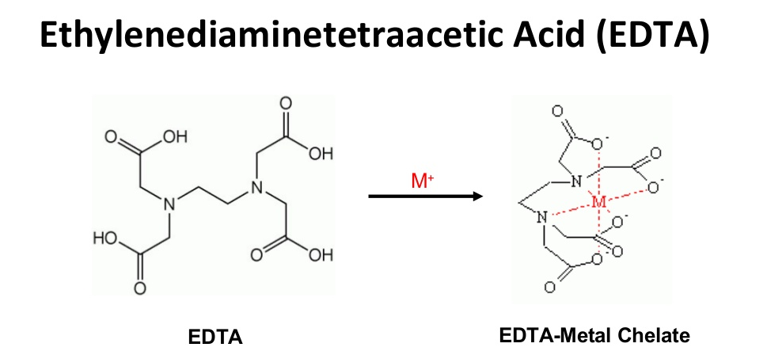
EDTA
,

Slide 22
EDTA
Potent chelator of calcium—causes tetany on i.v. injection.
When slow infusion given, tetany not occur, because Ca withdrawn from bones.
Can be used for emergency control of hypercalcemia: 50 mg/kg i.v. infusion over 2–4 hours, but bisphosphonates are preferred.

Slide 23
Calcium disodium ethylene diamine tetraacetic acid (CaNa2EDTA)

Slide 24
CALCIUM DISODIUM EDETATE (CaNa2EDTA)
Calcium chelate of Na2 EDTA
Hexadentate ("six-toothed") ligand and chelating agent
Poorly absorbed in the git (<5%) thus only administered by parenteral route
Painful at injection site so iv injection could be given by diluting in 5% D or NS
In blood, CaNa2EDTA is found only in the plasma.
CaNa2EDTA excreted in urine by glomerular filtration, so adequate renal function is necessary
Altering either the pH or the rate of urine flow has no effect on the rate of excretion.

Slide 25
CALCIUM DISODIUM EDETATE (CaNa2EDTA
Most important indication lead poisoning due to the capacity of lead to displace calcium from the chelate
Also useful in Cu, Mn,Cd, Fe, Zn,

Slide 26
Adverse effects
Principal toxic effect on the kidney by degeneration of proximal tubular cells.
Excessive thirst
An acute febrile reaction with chills, bodyache, malaise, fatigue lacrimation;
Glycosuria
Anemia
Dermatitis with lesions strikingly similar to those of vitamin b6 deficiency;
Transitory lowering of systolic and diastolic blood pressures;
Prolonged PT; and T-waveinversion on the electrocardiogram

Slide 27
(D-Pencillamine)

Slide 28
Penicillamine
It is dimethyl cysteine,
Obtained as a degradation product of penicillin.
thiol moiety in penicillamine can chelate Cu, Hg, Pb and Zn.
D-isomer is used therapeutically, because the l-isomer and the recemate produce optic neuritis and are more toxic.
Adequately absorbed after oral administration.
Little metabolized in the body and excreted in urine and faeces

Slide 29
Uses Pencillamine
Wilson’sdisease(Hepatolenticulardegeneration)
genetic deficiency of ceruloplasmin, a protein which normally binds and disposes off Cu from the body.
In its absence, plasma concentration of free Cu is high which gets deposited in liver, substantia nigra, basal ganglia of brain, and causes degeneration.
Copper poisoning drug of choice
mercury alternative drug to dimercaprol/Succimer poisoning
Chronic lead poisoning: as adjuvant to CaNa2EDTA, but succimer is preferred

Slide 30
Cystinuria and cystine stones: promotes excretion of cysteine and prevents its precipitation in the urinary tract, because penicillamine cysteine complex is more soluble than dicysteine (cystine).
Scleroderma: Penicillamine benefits by increasing soluble collagen.
As DMARD in Rheumatoid arthritis

Slide 31
Adverse effects:
Nausea, vomiting, abdominal discomfort and rashes (often with fever)
Loss of taste
Oral ulceration
Glomerulonephritis/Nephrotic syndrome
thrombocytopenia, neutropenia and rarely, aplastic anaemia.
lupus-like autoimmune reaction
antipyridoxine effect
Myasthenia gravis

Slide 32
Trientine
Trientine (triethylenetetramine dihydrochloride) orally alternative for patients with Wilson disease who are intolerant of penicillamine

Slide 33
(Deferoxamine)
picture from Themis atlas pharmacology 3e,P302

Slide 35
Desferrioxamine/Deferoxamine/DFO
Obtained from an actinomycete- Streptomyces pilosus
Straight chain DFO molecule winds around fe3+ and forms a stable nontoxic complex and excreted in urine as ferrioxamine
Removes loosely bound Fe as well as that from haemosiderin and ferritin, but not from haemoglobin or cytochrome.
Absorption poor after PO ---Parenterally administered. (im/iv/sc)
Very high affinity for iron: 1g is capable of chelating 85 mg of elemental iron.

Slide 36
Desferrioxamine indications
Acute iron poisoning: mostly seen in children
2. Transfusion siderosis: occurs in thalassemic who receive repeated BT
0.5–1 g/day i.m. helps to excrete the chronic iron overload;
i.v. concurrently with blood transfusion—2 g per unit of blood
3. With hemodialysis for aluminum toxicity in renal failure

Slide 37
Desferrioxamine adverse effects:
High frequency hearing loss / Tinnitus
Vision: loss of visual acuity, field defects, night vision or color vision
Impaired growth and skeletal development
Lung toxicity (pulmonary syndrome)
Increased risk of infection (Yersinia)
Can cause histamine release → fall in BP, flushing, itching, urticaria, rashes.
"vin ros," or deep red wine colored, urine is produced.
.

Slide 38
Deferiprone
Orally active iron chelator which has simplified the treatment of transfusion siderosis in thalassemia patients.
Excessive haemolysis occurs in these patients, and they have to be given repeated blood transfusions.
An iron chelator has to be used to clear the resulting iron overload.

Slide 39
Deferiprone
Oral deferiprone is a somewhat less effective alternative to injected desferrioxamine.
Deferiprone has also been indicated for acute iron poisoning (less effective than desferrioxamine) and for iron load in liver cirrhosis.

Slide 40
Deferiprone
Side effects
Anorexia, vomiting, altered taste, joint pain, reversible neutropenia, rarely agranulocytosis.Long-term safety is not yet known.

Slide 41
Summary
Copper Penicillamine, trientine(Copper penny)
Iron Deferoxamine, deferasirox, deferiprone
Lead EDTA, dimercaprol, succimer, penicillamine
Mercury Dimercaprol, succimer

Slide 42
THANK YOU

